Slide 1

Heart Disease Prediction Model

Slide 2
Introduction
Heart disease, one of the major causes of mortality worldwide.
Importance of heart disease diagnosis in the life.
Past data related to heart disease can help in predicting the presence of heart disease.
Using past data and applying ML technique helps in diagnosis of heart disease.

Slide 3
Literature Survey
PAPER | Technologies Used
HDPM: An Effective Heart Disease Prediction Model for a Clinical Decision Support System Norma Latif Fitriyani; Muhammad Syafrudin; Ganjar Alfian; Jongtae Rhee IEEE, 2020 | In the paper they have performed step by step methods to proceed towards training of the model. They have focused on data preprocessing and data balancing . Boosting algorithm is used to get better result But they have not any kind of parameter tuning to avoid overfitting of the model .

Slide 4
.
PAPER | TECHNOLOGIES USED
Prediction of Heart Disease Using Machine Learning Aditi Gavhane; Gouthami Kokkula; Isha Pandya; Kailas Devadkar IEEE, 2018 | Cleveland dataset from UCI library is used neural network algorithm multi-layer perceptron (MLP) is used to train and test the dataset Multi Layered Perceptron (MLP) is used in this paper because of its efficiency and accuracy new algorithms can be proposed to achieve more accuracy and reliability
.

Slide 5
Objective
Creating an efficient Heart disease prediction model using a sequence of ML technique and standard dataset
Compare our model with other existing model
Parameter tuning for getting better result

Slide 6
Datasets
1.Statlog(https://www.kaggle.com/datasets/shubamsumbria/statlog-heart-data-set?select=statlog.csv)
Dataset consists of 270 subjects, 13 attributes and one output class (120 and 150 subjects are labelled with the presence (positive class) and absence (negative class) of heart disease, respectively).
2.Cleveland(https://www.kaggle.com/datasets/cherngs/heart-disease-cleveland-uci?select=heart_cleveland_upload.csv)
Dataset consists of 303 subjects with 138 and 165 subjects being labelled with the presence (positive class) and absence (negative class) of heart disease, respectively.

Slide 7
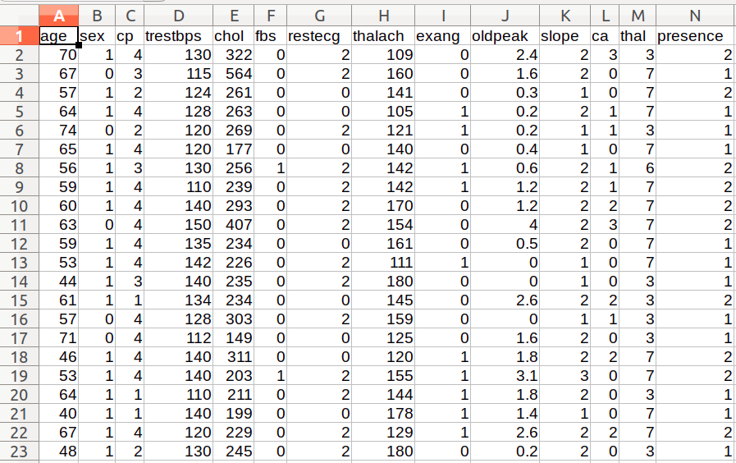

Slide 8
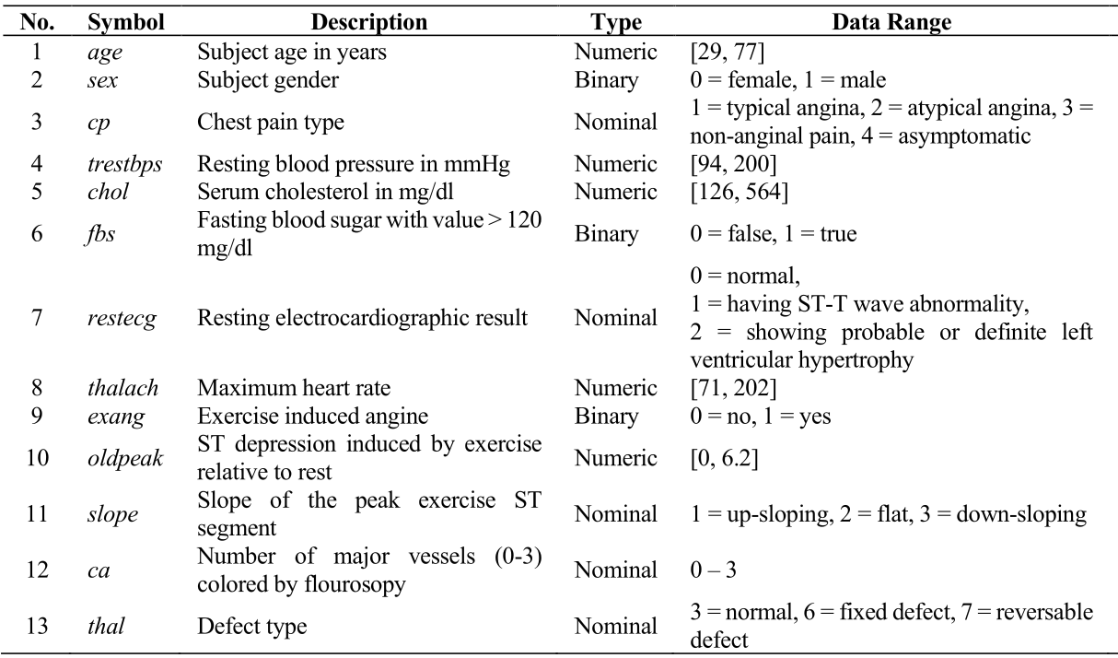
Attribute description

Slide 9
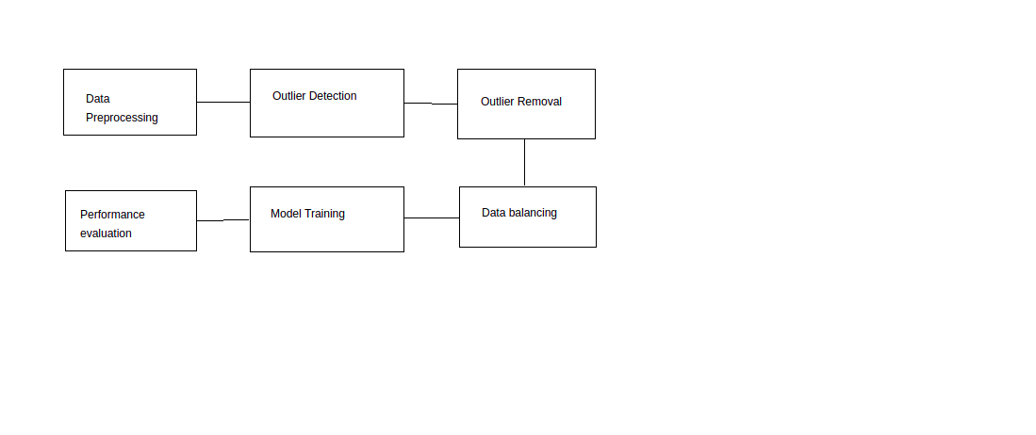
Methodology
Data Preprocessing
Outlier Detection and removal
Data balancing
Data training
Performance evaluation

Slide 10
Process on Data
Data Preprocessing - Pearson Correlation coefficient, Information gain
Outlier Detection and Removal - DBSCAN Algo
Data Balancing - SMOTEENN

Slide 11
Training of Model
Applying GA to get best parameter
Train Model using XGB classifier

Slide 12
Performance Evaluation
Accuracy
F1 score
Recall
Precision
MCC
TNR
FNR
FPR

Slide 13
Work Done and Results
Attribute Selection using PCC and Information gain
Outlier Detection and removal using DBSCAN
Data balancing using SMOTEENN
Applying GA
Training and testing of model
Performance evaluation
Model comparison

Slide 14
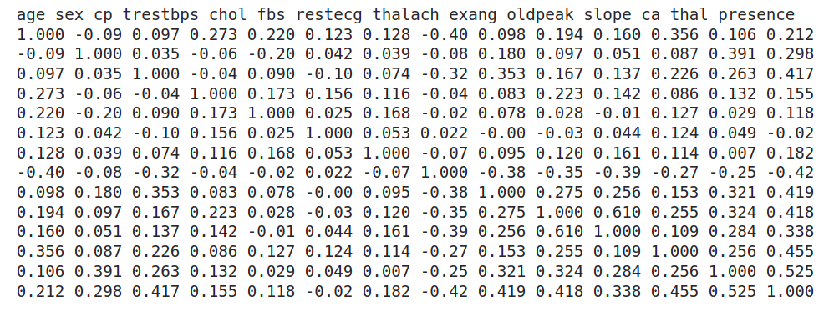
Pearson Correlation coefficient

Slide 15
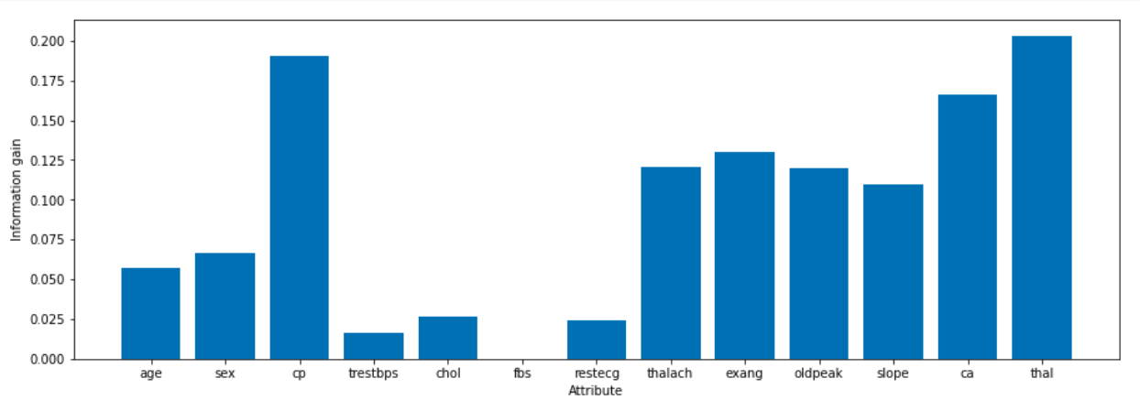
Information gain

Slide 16
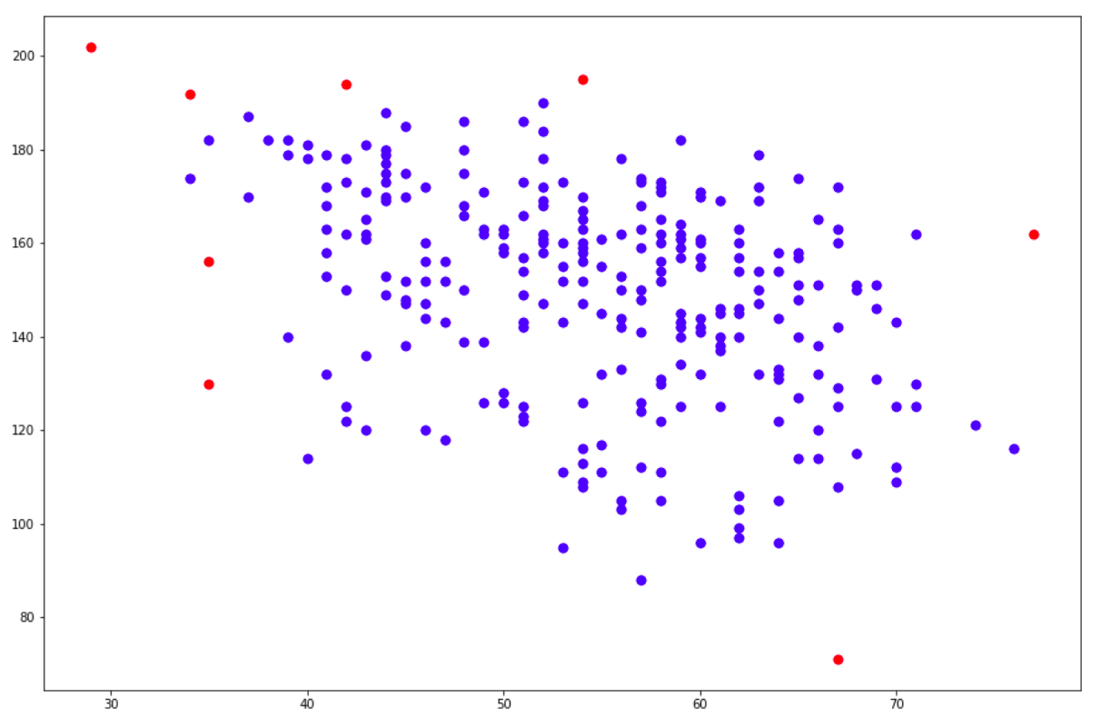
Outlier detection

Slide 17
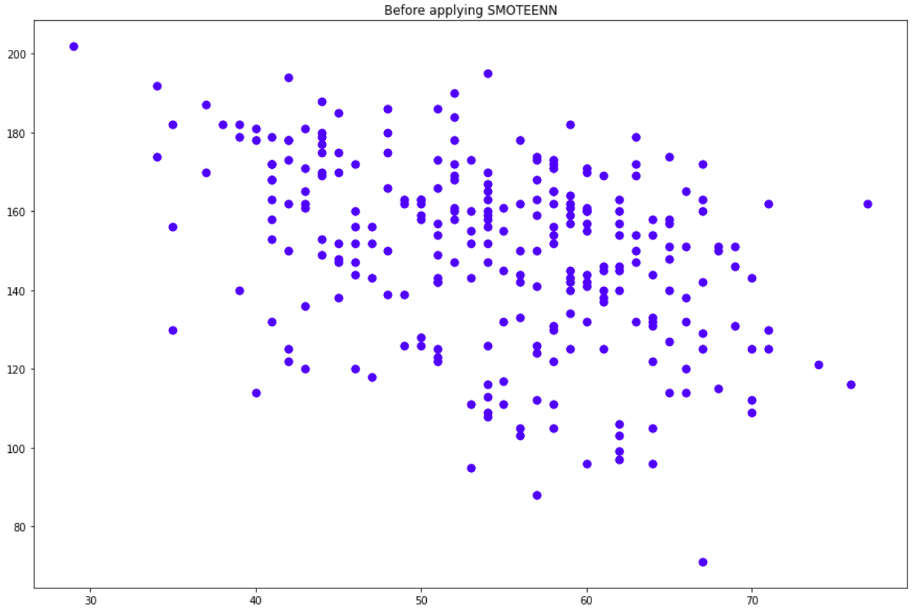
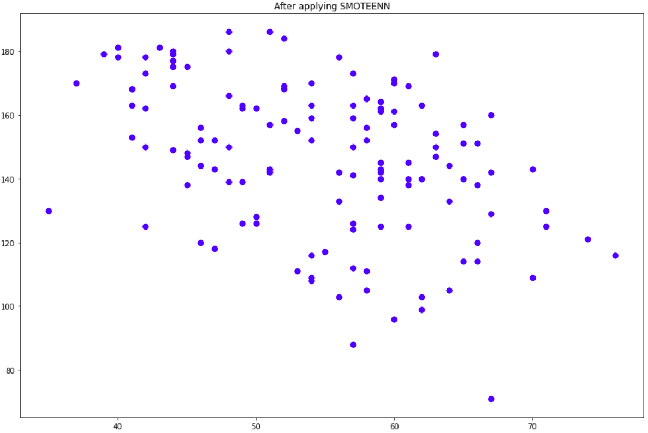
Data balancing

Slide 18
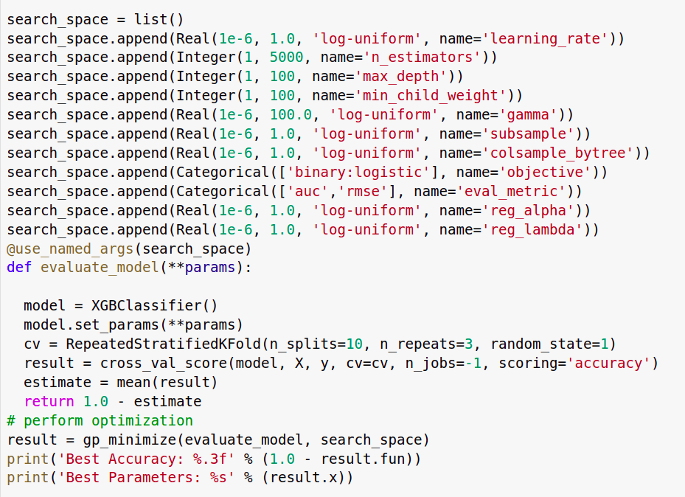
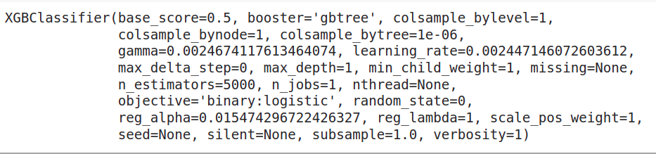
Genetic Algorithm

Slide 19
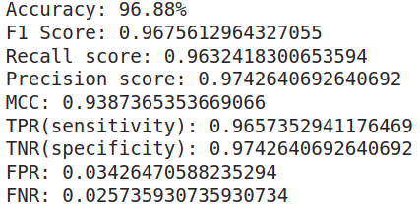
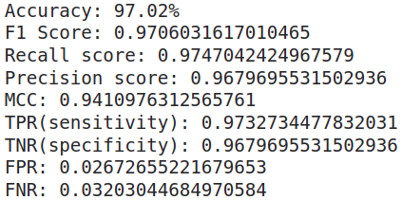
Results

Slide 20
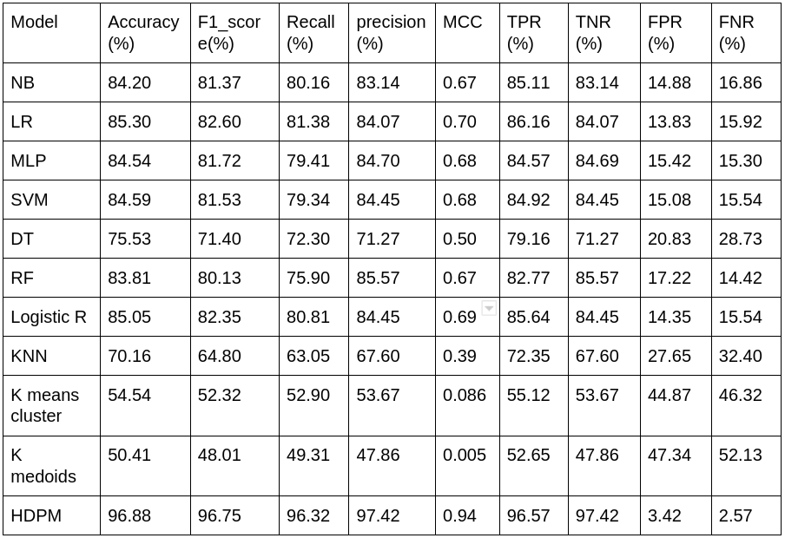

Slide 21
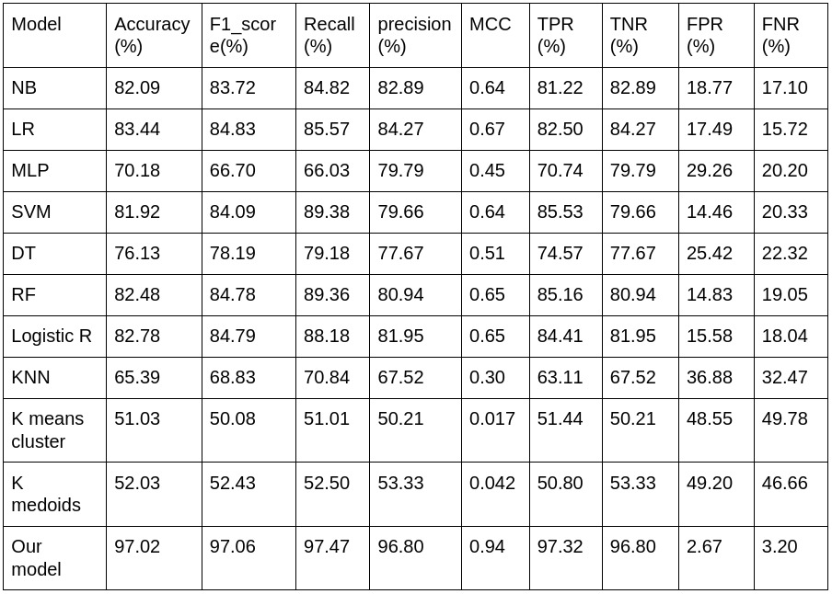

Slide 22
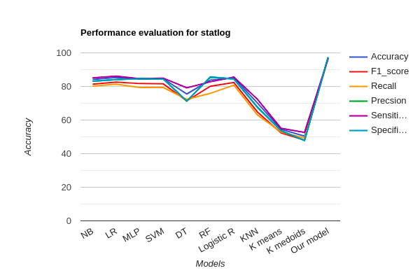
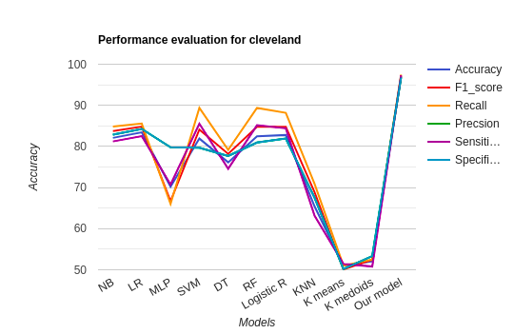
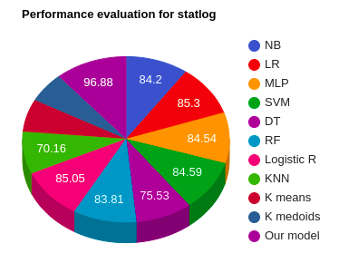


Slide 23
Conclusion
The Heart Disease Prediction System using Machine learning algorithm(XGboost)
hybrid model which is combination of DBSCAN, SMOTEENN, GA, XGboost is proposed
the algorithm gives the nearby reliable output based on the input provided by the users.
If the number of people using the system increases, then the awareness about their current heart status will be known
the rate of people dying due to heart diseases will reduce eventually.

Slide 24
Reference
[1] N. L. Fitriyani, M. Syafrudin, G. Alfian and J. Rhee, "HDPM: An Effective Heart Disease Prediction Model for a Clinical Decision Support System," in IEEE Access, vol. 8, pp. 133034-133050, 2020, doi: 10.1109/ACCESS.2020.3010511.
[2] A. Gavhane, G. Kokkula, I. Pandya and K. Devadkar, "Prediction of Heart Disease Using Machine Learning," 2018 Second International Conference on Electronics, Communication and Aerospace Technology (ICECA), 2018, pp. 1275-1278, doi: 10.1109/ICECA.2018.8474922.
[3] Statistics Korea. (2018). Causes of Death Statistics in 2018. [Online].
[4] World Health Organization. (2017). Cardiovascular Diseases (CVDs).
[5] P. Greenland, J. S. Alpert, G. A. Beller, E. J. Benjamin, M. J. Budoff, Z. A. Fayad, E. Foster, M. A. Hlatky, J. M. Hodgson, F. G. Kushner, M. S. Lauer, L. J. Shaw, S. C. Smith, A. J. Taylor, W. S. Weintraub, and N. K. Wenger, “2010 ACCF/AHA guideline for assessment of cardiovascular risk in asymptomatic adults.
[6] J. Perk et al., “European guidelines on cardiovascular disease prevention in clinical practice (version 2012)

Slide 25
Thank You

